Slide 1

ADVANCED FRONT END DEVELOPMENT
Gjorge Dimitrov
Trainer
Olga Penovska
Assistent

Slide 2
01
02
03
Modern CSS
SASS, SCSS & LESS
Advanced CSS
What we will learn
Variables, Flexbox, Grid
BEM & the CSS preprocessors
Inheritance, dynamic values, customizing libraries
04
05
06
Typescript
JS Frameworks
Project
Typed JavaScript
React, Angular, Vue
Let’s build something, with the new tools we learned

Slide 3

01
HTML
What did we learn about HTML?

Slide 4
How did we get to here?

Slide 5
HTML
Semantic HTML5 tags
Attributes
Elements
Head & Body
Script & Link

Slide 6
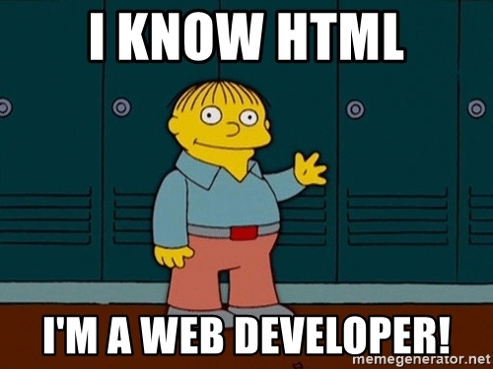

Slide 7

02
CSS

Slide 8
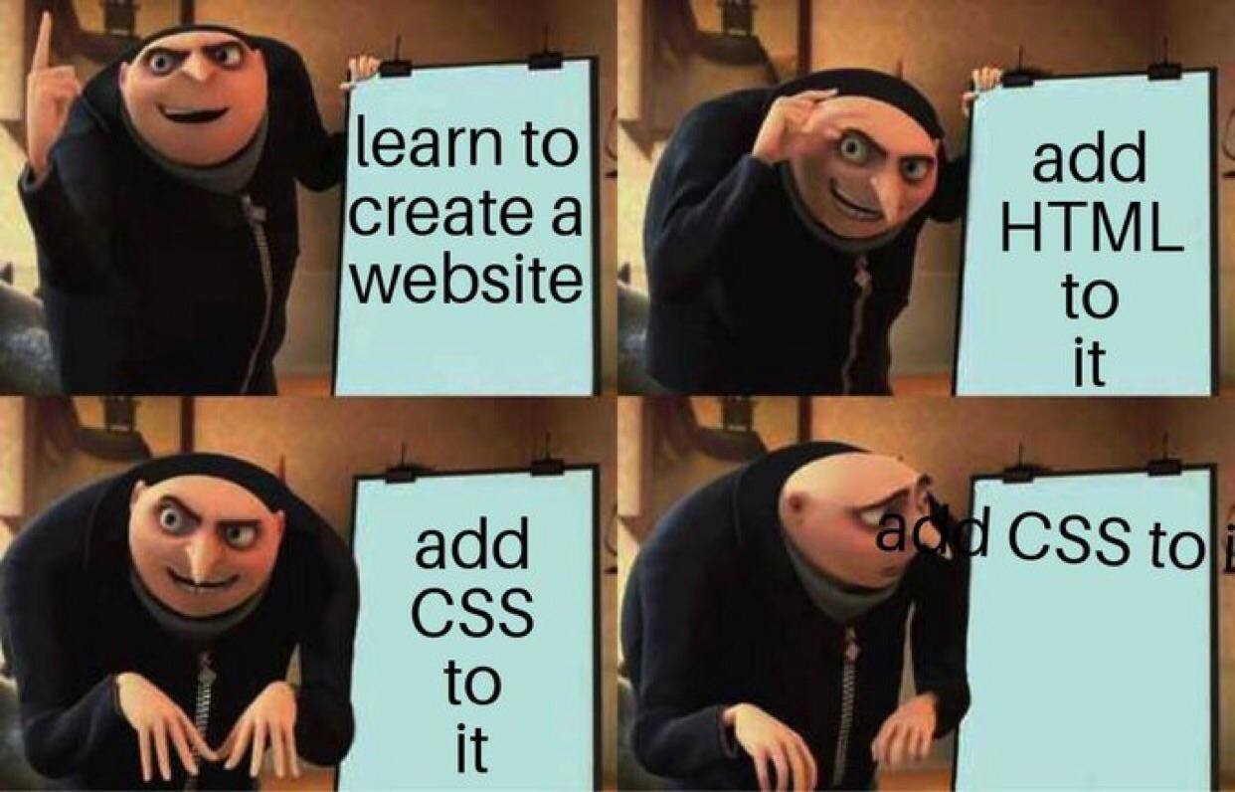

Slide 9
CSS
Selectors
Grid
Type of values
Positioning
Animations & Transitions

Slide 10
CSS practices
GOOD
BAD
Using selector strength
BEM or other naming methodology
Using reusable classes
Using Flexbox instead of float
Using Inverted triangle or other organization method for css
Using inheritance
Camel Case classes
Targeting elements using id selectors in CSS
Code indentation
Inline styles
Incorrectly Using Positioning
Using improper values for properties (color names, 0px etc.)
Using !important
<number>

Slide 11
What new will we learn about CSS?
Using Flexbox and Grid to position elements
Inheritance in CSS
CSS Variables
Mobile first VS Desktop First

Slide 12
What are CSS preprocessors?
SASS, SCSS, LESS
Variables, mixins, extends
@if, @else, @else if and @if not: Sass conditional statements
@for, @each and @while loops in Sass and SCSS

Slide 13

03
JavaScript
undefined

Slide 14
JavaScript
ECMAScript
Variable scoping
Event loop
Types
Asynchronous VS Synchronous

Slide 15
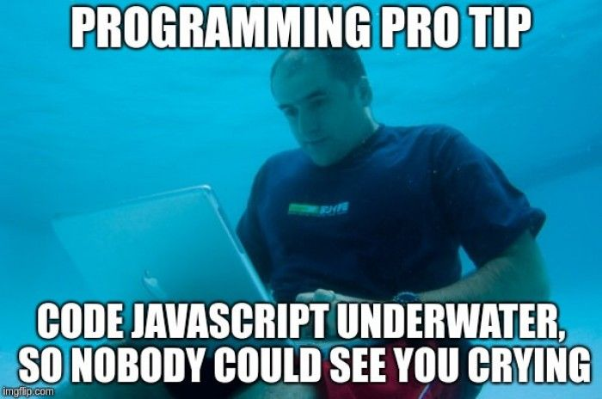

Slide 16
JavaScript practices
GOOD
BAD
Using let & const
Using naming conventions
Using ===
Declaring global variables
Optimizing the code
Dom manipulation with event listeners
DRY
Using var
Using terrible names
Using ==
Declaring variables in proper scope
Using unnecessary loops and/or recursion
Using inline event handlers
<number>

Slide 17
What new will we learn about JS?
How to add TypeScript to your project
What is TypeScript, and why is it so popular?
What are JS libraries, and what are JS frameworks and why there are more than 100 of them!?

Slide 18
Frameworks
Class based vs Function based components
Services, Modules, Directives, Decorators, Pipes, Hooks...
Fetching data, Data binding, Virtual DOM

Slide 19



Most popular JS Frameworks
React
Angular
Facebook
Google
Vue
Open-source

Slide 20
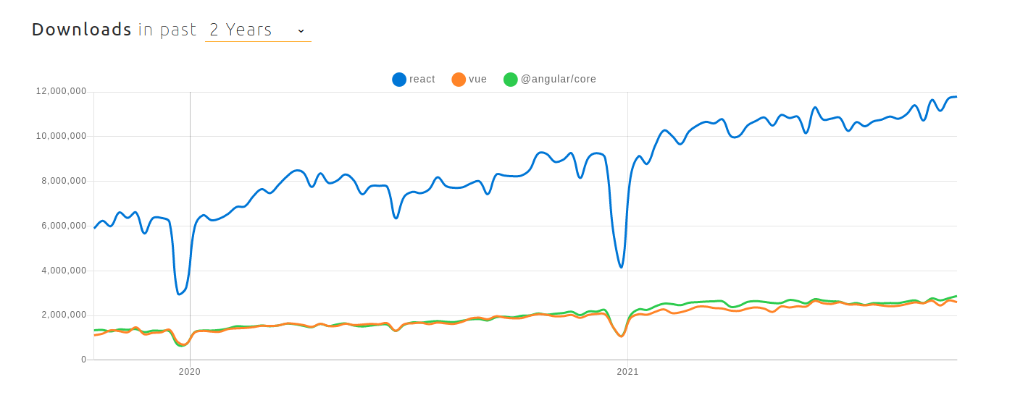
React vs Angular vs Vue: Popularity

Slide 21
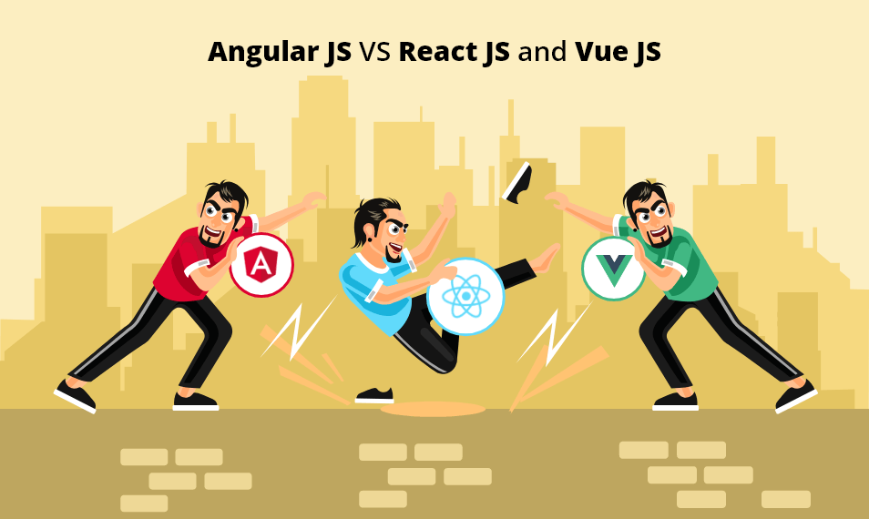

Slide 22
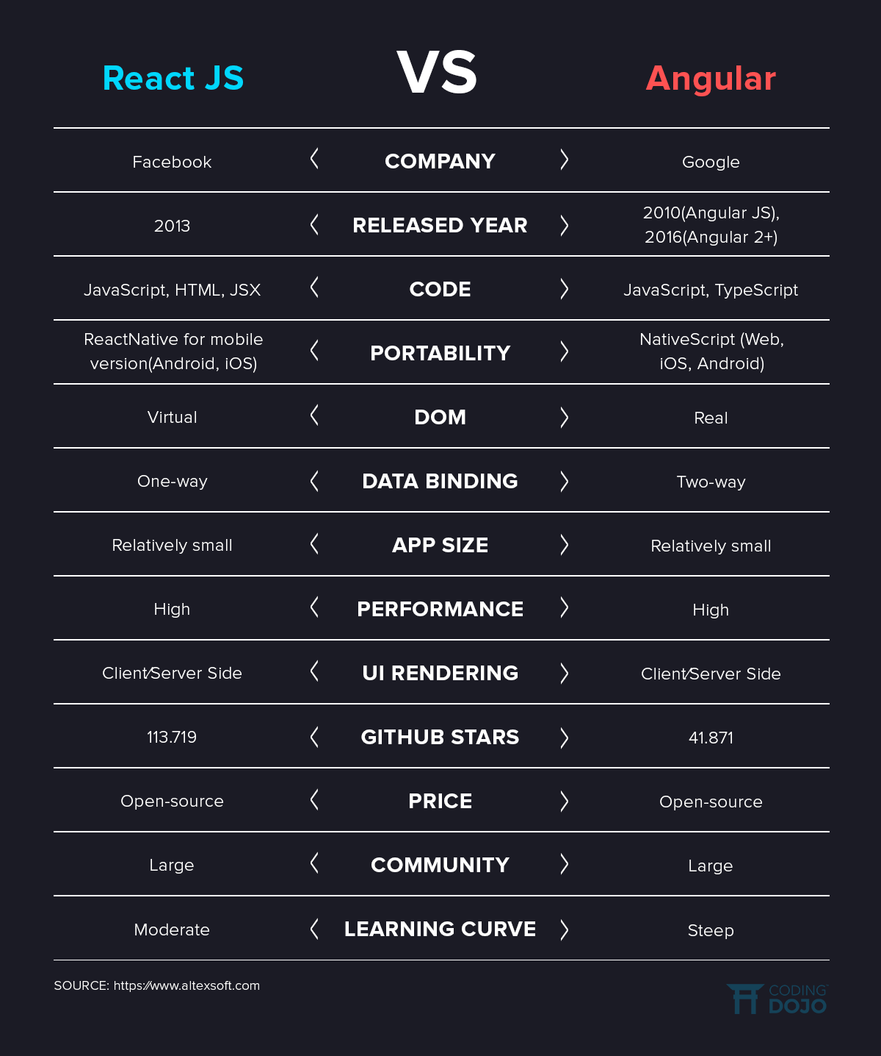
Angular VS React comparison

Slide 23
Let’s choose our weapon

Slide 24


The FE Team
Gjorge Dimitrov
Olga Penovska
Front End Developer
Front End Developer

Slide 25

THANKS
Does anyone have any questions?
george.dimitrov@ludotech.co
penovska.olga@gmail.com

